Slide 1
MODULE 5 (Regular Expressions)

Slide 2
Regular expression
A RegEx, or Regular Expression, is a sequence of characters that forms a search pattern.
Regular Expressions (regex) in Python allow you to search, match, or manipulate strings with a specific pattern.
They are powerful for finding patterns in text, extracting information, or validating data.

Slide 3

RegEx Module
Python has a built-in package called re, which can be used to work with Regular Expressions.
Import the re module:

Slide 4
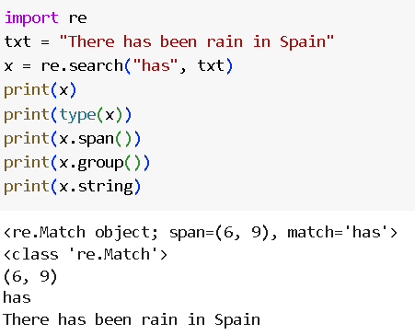

Slide 5
<re.Match object>: This indicates that a match object was returned.
The match object contains details about the match found using the re module's search, match, or other related methods.
span=(6,9): The span indicates the starting and ending positions of the match in the input string. It’s a tuple that represents the range where the matched pattern is found. In this case, the match starts at index 6 and ends at index 9.

Slide 6
match=' ': This shows the exact content that was matched in the input string. Here, the matched content is a space character (‘has’).
.string returns the string passed into the function.
.group() returns the part of the string where there was a match

Slide 7
RegEx Functions
Function | Description
re.match() | Returns if Match Object if there is a match from the start of the string
re.findall() | Returns a list containing all matches
re.search() | Returns a Match Object if there is a match anywhere in the string
re.split() | Returns a list where the string has been split at each match
re.sub()/ re.subn() | Replaces one or many matches with a string

Slide 8
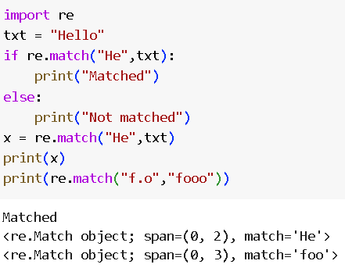
.match()

Slide 9
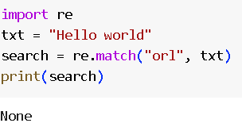
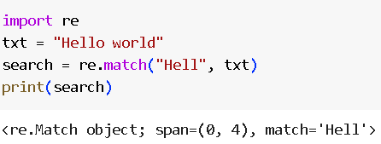

Slide 10
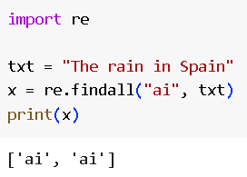
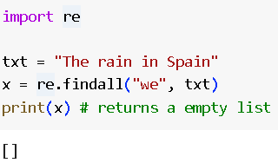
.findall()

Slide 11
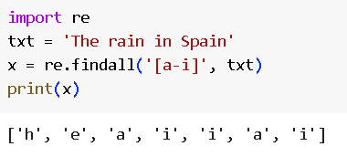

Slide 12
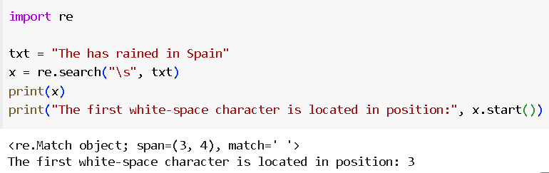
.search()
The search() function searches the string for a match, and returns a Match object if there is a match.
If there is more than one match, only the first occurrence of the match will be returned:

Slide 13
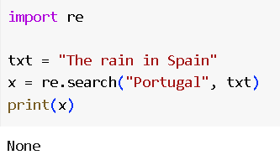
If no matches are found, the value None is returned:

Slide 14
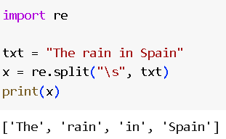
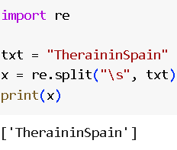
.split()
The split() function returns a list where the string has been split at each match:

Slide 15
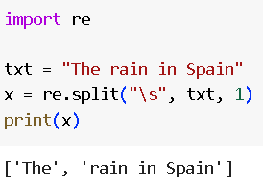
You can control the number of occurrences by specifying the maxsplit parameter:

Slide 16
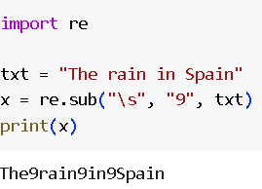
.sub()
The sub() function replaces the matches with the text of your choice

Slide 17
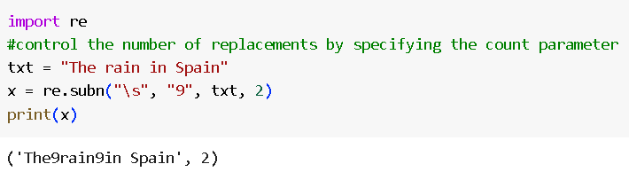
.subn()
subn() is similar to sub() except it returns a tuple of 2 items containing the new string and the number of substitutions made.

Slide 18
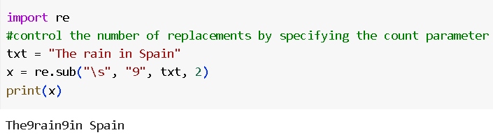

Slide 19
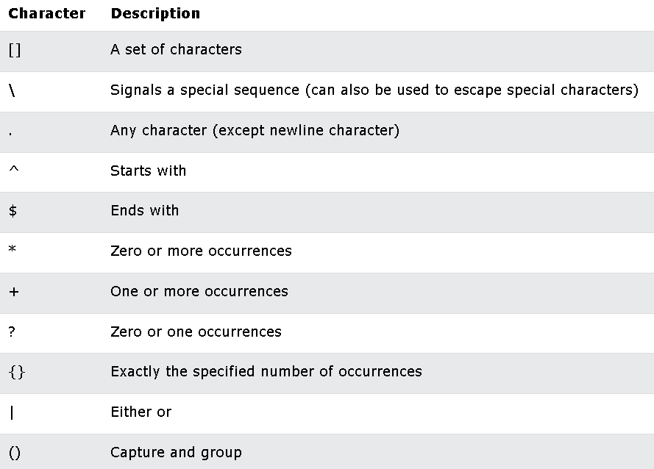
Metacharacters

Slide 20
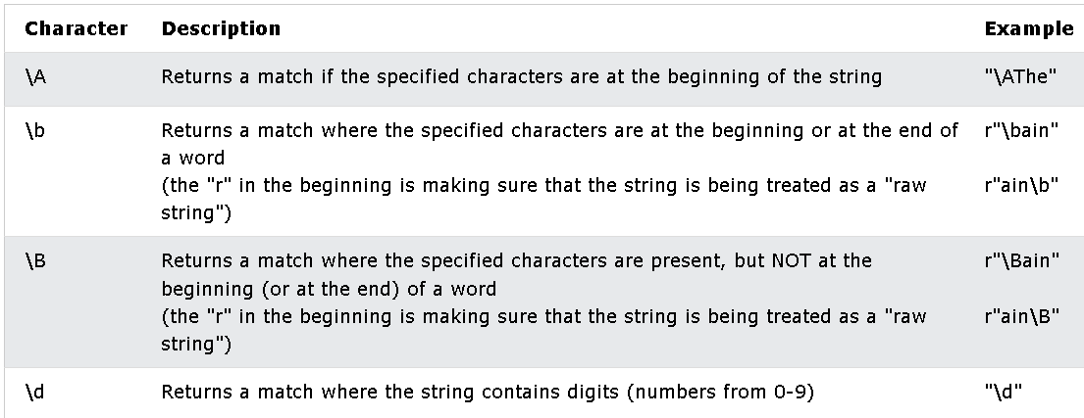
Special Sequences

Slide 21
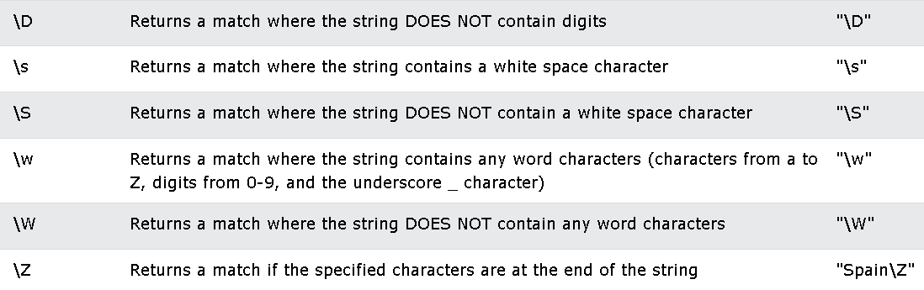
Special Sequences

Slide 22
Regular Expression Quick Guide
^ Matches the beginning of a line
$ Matches the end of the line
. Matches any character
\s Matches whitespace
\S Matches any non-whitespace character
* Repeats a character zero or more times
*? Repeats a character zero or more times (non-greedy)
+ Repeats a character one or more times
+? Repeats a character one or more times (non-greedy)
[aeiou] Matches a single character in the listed set
[^XYZ] Matches a single character not in the listed set
[a-z0-9] The set of characters can include a range
( Indicates where string extraction is to start
) Indicates where string extraction is to end

Slide 23
Many times
Match the start of the line
^X.*:
Match any character

Slide 24
One or more times
Match the start of the line
^X-\S+:
Match any non-whitespace character

Slide 25
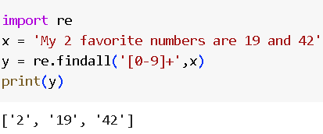
Matching and Extracting Data
[0-9]+
One or more digits

Slide 26
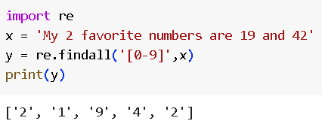

Slide 27
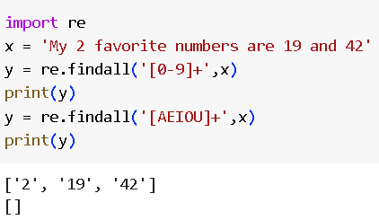

Slide 28
Warning: Greedy Matching
One or more characters
^F.+:
First character in the match is an F
Last character in the match is a :

Slide 29
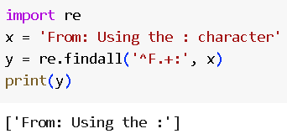

Slide 30
Non-Greedy Matching
One or more characters but not greedy
^F.+?:
First character in the match is an F
Last character in the match is a :

Slide 31
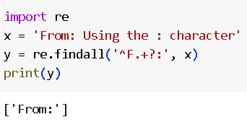

Slide 32
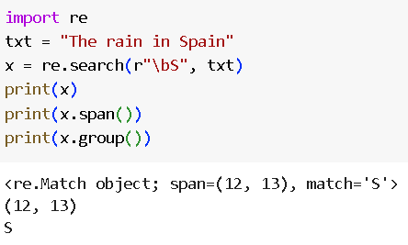

Slide 33
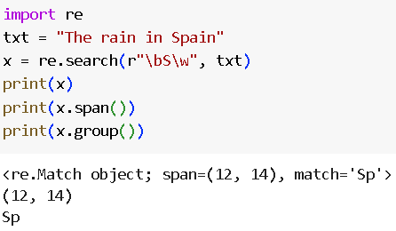

Slide 34
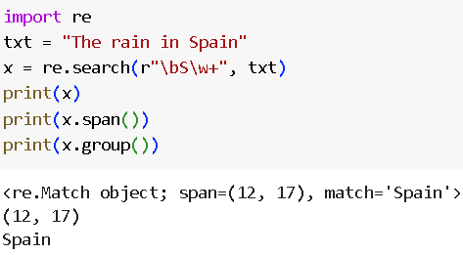

Slide 35
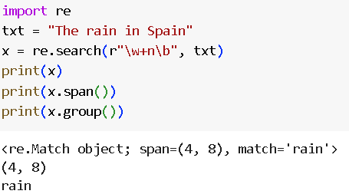

Slide 36
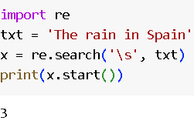

Slide 37
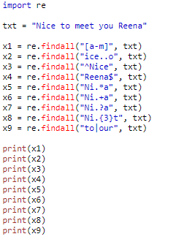
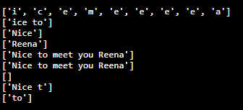

Slide 39
Special Sequences

Slide 40
Special Sequences

Slide 41
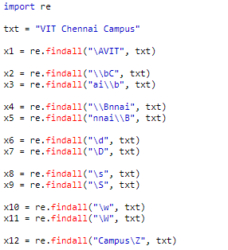

Slide 42
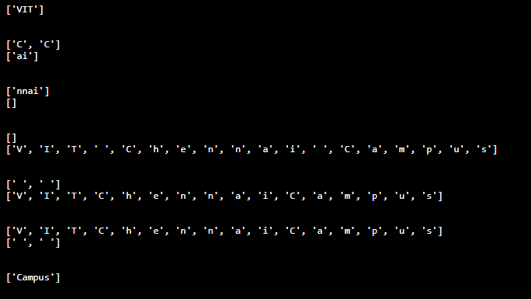

Slide 43
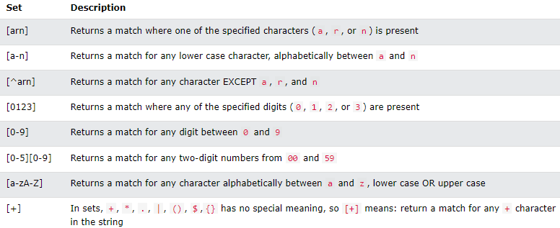
sets
A set is a set of characters inside a pair of square brackets [] with a special meaning

